Slide 1

Customer Shopping Behavior Analysis
Uncovering insights from transactional data to guide strategic decisions.

Slide 2



Project Overview
Goal
Data
Impact
Analyze spending patterns, segments, preferences, and subscription behavior.
3,900 purchases across various product categories.
Inform strategic business decisions.

Slide 3

Dataset Summary
Key Features
Customer demographics (Age, Gender, Location, Subscription)
Purchase details (Item, Category, Amount, Season, Size, Color)
Shopping behavior (Discount, Promo, Previous Purchases, Frequency, Review, Shipping)

Slide 4





Exploratory Data Analysis (Python)
Data Loading
Initial Exploration
Missing Data Handling
Column Standardization
Ensuring data quality and readiness for analysis.

Slide 5

Feature Engineering & Consistency
New Features
Age Group (binned ages)
Purchase Frequency (days)
Data Consistency
Dropped redundant 'promo_code_used'
Loaded cleaned data to PostgreSQL

Slide 6
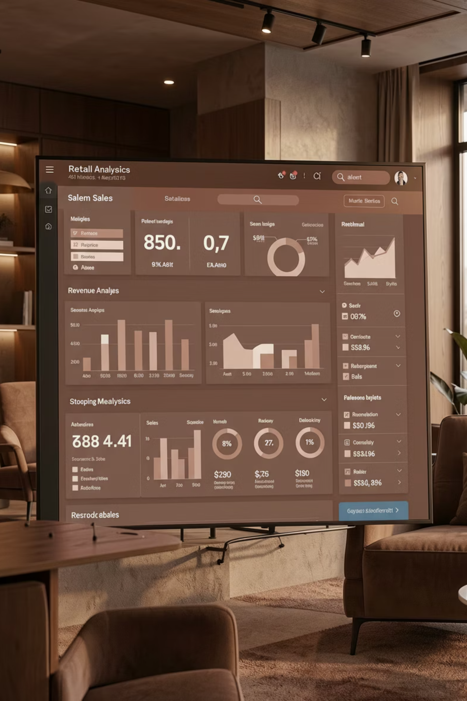



Data Analysis (SQL)
Revenue by Gender
Male: $157,890, Female: $75,191
High-Spending Discount Users
839 customers spent above average with discounts.
Top 5 Products by Rating
Gloves, Sandals, Boots, Hat, Skirt.

Slide 7




SQL Insights Continued
Shipping Type Comparison
Subscribers vs. Non-Subscribers
Express: $60.48 avg, Standard: $58.46 avg.
Avg spend similar, non-subscribers higher total revenue.
Discount-Dependent Products
Customer Segmentation
Hat, Sneakers, Coat, Sweater, Pants.
Loyal (3116), Returning (701), New (83).

Slide 8


Deep Dive: Product & Age
Top 3 Products per Category
Revenue by Age Group
Accessories: Jewelry, Sunglasses, Belt
Clothing: Blouse, Pants, Shirt
Footwear: Sandals, Shoes, Sneakers
Outerwear: Jacket, Coat
Young Adult: $62,143
Middle-aged: $59,197
Adult: $55,978
Senior: $55,763

Slide 9

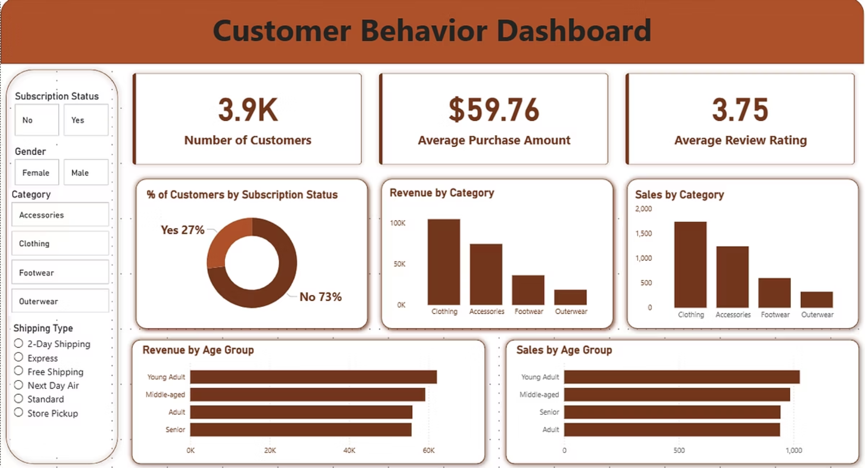
Dashboard in Power BI
Interactive visualizations for key metrics and trends.

Slide 10




Business Recommendations
Boost Subscriptions
Customer Loyalty
Promote exclusive benefits.
Reward repeat buyers.
Review Discount Policy
Targeted Marketing
Balance sales with margins.
Focus on high-revenue age groups.

